Slide 1

The Supernatural Intervention
By Sue Thomp
(Sample Archetype Power Point)

Slide 2
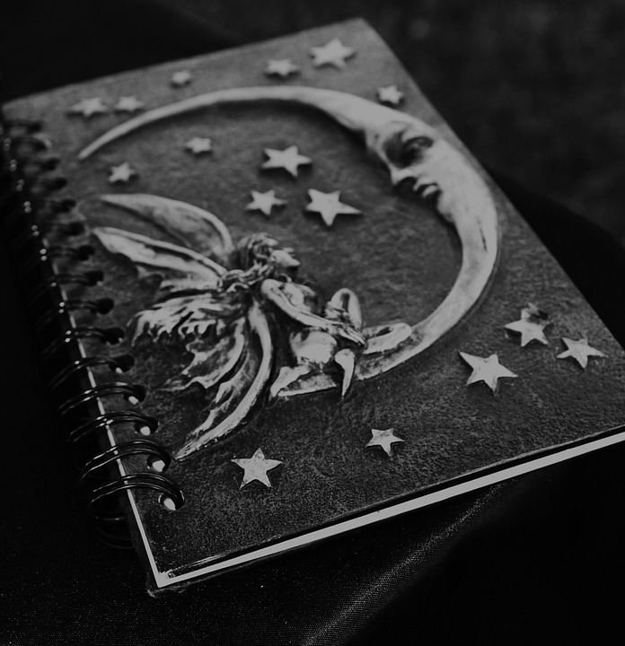
What Is It?
Supernatural intervention is a symbolic archetype.
It’s seen across other archetypes like character archetypes.
It’s seen in legends and other genres or works of literature.
  Example: “Beowulf.”
It is mainly characterized as an intervention from a god or gods in human affairs.
This intervention tends to affect the fate or destiny of the hero or main character.
Notes:
The supernatural intervention archetype is a symbolic archetype; however, it can be seen across archetypes of various categories. It is seen in many of the legends we read such as the epic, “Beowulf,” “King Arthur,” and other works of literature. Much of the literature that includes supernatural intervention shows gods or witches working against or on behalf of the hero or main character. This intervention affects the fate or destinity of the hero, who usually has to make a decision concerning a conflict in the story.

Slide 3
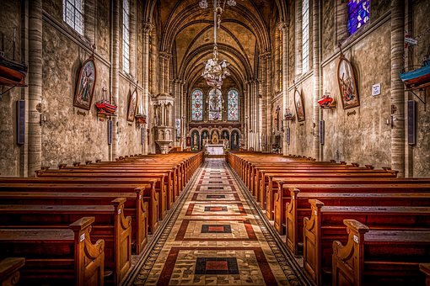
Christian BackDrop
Anglo-saxon texts such as “Beowolf,” show similar elements to those seen in the Bible.
The “Super-natural”– “Super” and “Nature”—can be seen as “God’s nature” (Knight).
Also refers to the frailty of humans, who are prone to error. The divine has to step in to fix things.
Notes:
Many of the stories we read in the course, show a Christian context. Anyone familiar with the Bible, may recognize similar elements in legends, or particular Anglo-Saxon literature such as “Beowulf.” A breakdown of the words “Super” and “Natural” may allow us to understand the significance of the archetype. In defining the words, George Knight suggested that supernatural refers to God and the characteristics of God. Because humans are prone to error and are often considered frail, divine intervention is necessary to keep things in order.

Slide 4
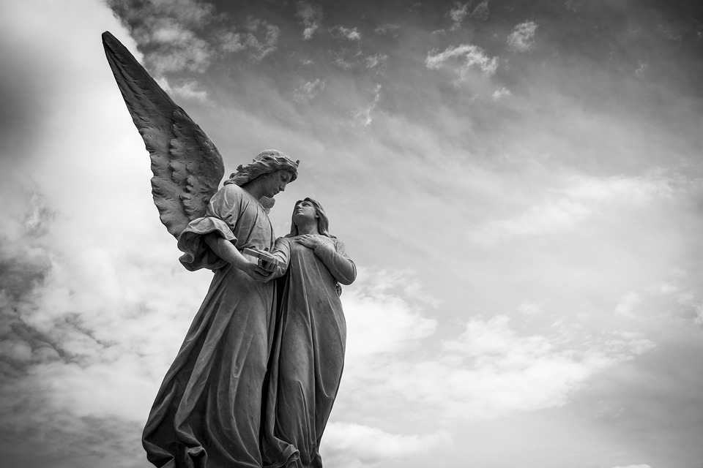
Importance
Is a symbolic archetype, but can be seen in other archetype categories.
It’s necessary in both literature, and real life.
People are often faced with problems that keep them from functioning normally.
Supernatural Interventions involves a person’s reliance on faith. However, sometimes the intervention is not desired.
This is the greatest archetype because it is what allows a person to hope for the best outcome, when faced with the impossible. It’s great because we all seek it out.
Notes:
A supernatural intervention is often necessary; not just in literature, but in real life. People are often faced with problems that keep them from functioning normally. When this happens, they rely on faith. It is at this point that a supernatural intervention is warranted. In literature, sometimes the intervention is not desired or welcomed, however it often propels the main character, or hero, forward. This is the greatest archetype because it is what allows a person to hope for the best outcome, when faced with the impossible.

Slide 5

Roles and Examples
The fairy godmother in “Cinderella” and other tales show us the importance of the supernatural. She intervenes and leads Cinderella to the ball, where Cinderella meets her soon-to-be prince.
The main character is sometimes guided or sent to his or her doom by the supernatural—either way, the character’s fate can be affected by this intervention.
Greek gods in legends and mythology are considered supernatural, and are depicted as those to intervene in human affairs.
Notes:
This archetype can be seen in stories like Cinderella and in Greek mythology. Often, these supernatural beings help the main character achieve a goal or purpose. The idea of fate or a person’s purpose is intertwined within this relationship that develops between the main character and the supernatural.

Slide 6
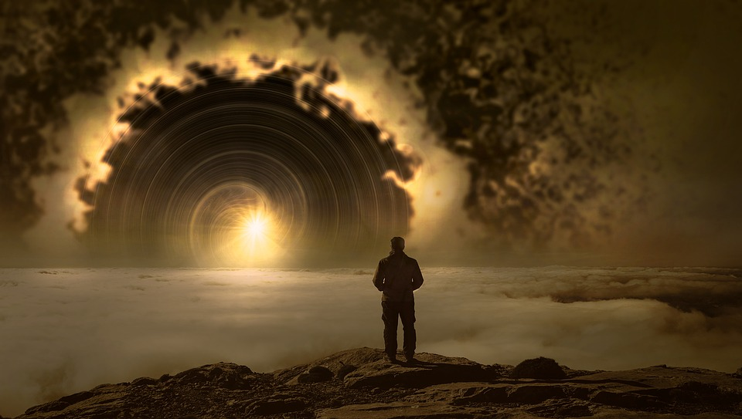
This Archetype Resonates with Most People
We seek out answers to the unknown. “The hunt for god or a higher existence is to find the true meaning of life” (Tiwari).
Often, the supernatural gets us to arrive at the answers we seek.
Throughout human’s history, there is the constant quest for something more.
The archetype resonates with us because we are wired to believe in something beyond ourselves.
Notes:
The idea of the supernatural is common in literature and in history. The belief in a god or gods is a common part of humanity and life, as many of us know it. This archetype resonates with many of us because of the part of us that seeks for more. It is human nature to want answers to the unknown and to seek out answers beyond ourselves. Tiwana, writer and blogger, said it like this, “The hunt for god or a higher existence is to find the true meaning of life.”

Slide 7
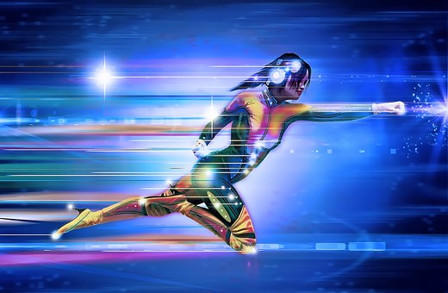
SuperNatural Heroes
Supernatural intervention can be seen in the hero archetype at times.
  Beowulf is an example—super human strength
  Hercules
In TV shows like “Marvel’s Agents of Shield,” the heroes have super powers, which allows them to intervene supernaturally.
Other shows or comics such as “Superman” and “Spiderman” allow the hero to be the supernatural force that intervenes.
Notes:
In the epic poem, “Beowulf,” Beowulf, the hero and main character, has inhuman strength, which allows him to keep his fellow citizens safe. In Marvel’s Agents of Shield, the super inhumans intervene to help regular citizens faced with extraordinary opposition.

Slide 8
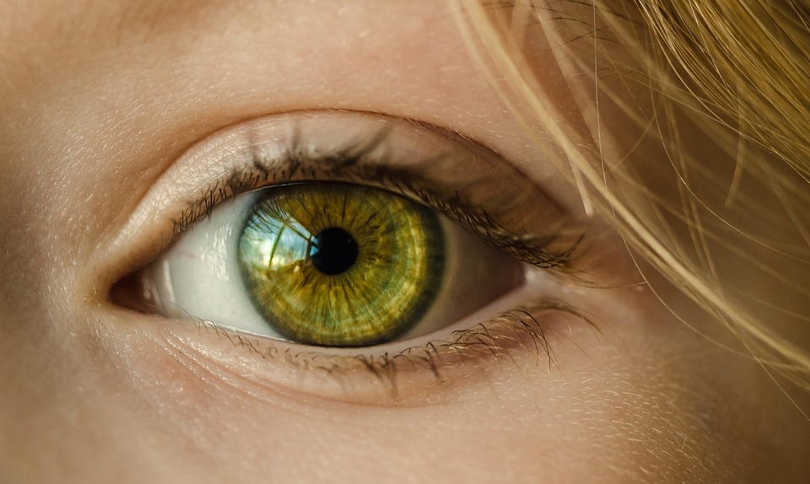
Reflecting Human Nature
Including the supernatural gives us insight into who we are as humans.
What makes us strong and what makes us weak?
Do we depend on the divine, or do we depend on ourselves?
Shakespeare included the supernatural in some of his plays such as Macbeth and Hamlet
  Show human struggles
  Societal struggles.
Notes:
Including the supernatural in literature enables us to critique ourselves as humans. It goes to the heart of what it really means to be human. Who will we rely on in the face of evil? Shakespeare included the supernatural in some of his plays such as Macbeth and Hamlet—allows us to see the inner turmoil humans face and the societal issues that are prevalent among humans.

Slide 9
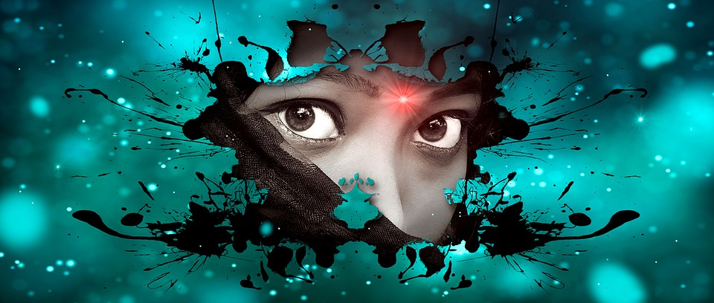
Conclusion
Supernatural intervention in literature serves various purposes:
  Its inclusion gives us a reflection of humanity and human capabilities
  It reveals a search for knowledge
  It creates a backdrop for common issues we face in society and in humanity
It is the greatest archetype because…
  We all have a need for answers
  Most of us seek out the supernatural for help with the seemingly impossible.
  And we can all relate to a need for something beyond ourselves
Notes:
Without a shadow of a doubt, this is the greatest archetype because it is common to us all. We all have a need for answers, and we either search within ourselves or seek it beyond ourselves. Including supernatural intervention archetypes in literature opens up our eyes to humanity. What are we capable of? How do we overcome the impossible?

Slide 10
Works Cited
Knight, George T. “The Definition of the Supernatural.” The Harvard Theological Review, vol. 3, no. 3, 1910, pp. 310–324. JSTOR, www.Jstor.Org/stable/1507012.
Tiwari, Ishita. “Creating a Life with an Abstract Inspiration.” Quora, 10 Apr. 2018. https://www.Quora.Com/why-do-humans-always-seek-the-unknown . Accessed July 5, 2019.

